Slide 1
Statistical Analysis and Predictive Modeling of the Ames Housing Dataset
Stephen Codoluto
Purdue University - MSDS GRAD50500
February 2026

Slide 2

Outline
Introduction and Project Overview
Research Questions and Hypothesis
Analysis
Exploratory Data Analysis
Research Question 1
Research Question 2
Research Question 3
Conclusions and Key Findings
Backup
Methodology and Assumption Validation
References

Slide 3
Introduction and Project Overview
This report provides an analysis of the Ames Housing Dataset.
The dataset was originally compiled by Dean De Cock from the Ames City Assessor’s Office and published in the Journal of Statistics Education in 2011.
Objective: Apply hypothesis testing and statistical analysis techniques to better understand the factors that drive home sale prices.
Framed using three research questions.
Each question was evaluated using statistical methods to test hypotheses about correlations between home features and price, neighborhood effects, and median sale price predictions.
Dataset Overview
Meta-data | Description
File Format | Comma-Separated Values
Data Type | Tabular / Structured, 1 observation per row
Observations | 400 random houses selected of 2,929 total available
Variables | 82 columns (23 nominal, 23 ordinal, 14 discrete, 20 continuous, 2 identifiers)
Granularity | Individual residential property (one row per house sale)
Temporal Details | 2006 – 2010 (sales dates)
Geographic Details | Ames, Iowa, USA - subdivided into neighborhoods
https://www.openintro.org/data/index.php?data=ames

Slide 4



Research Questions and Hypothesis
What physical attributes of a home most strongly predict its sale price?
Research Question 2
Does neighborhood significantly affect home sale prices with house size, quality, and other impactful variables controlled?
Can it be predicted whether a house will sell above the median price based on its features?
H₀: Model classification accuracy = 0.5.
Research Question 1
H₁: At least one regression coefficient ≠ 0.
H₁: Neighborhood has a significant effect on price after controlling for physical features.
H₁: Model accuracy > 0.5 - better than random chance.
H₀: Neighborhood has no effect on price after controlling for physical features.
H₀: All regression coefficients = 0.
Research Question 3
Statistical Methods/Tests:
Multiple Linear Regression
F-test / t-tests
Statistical Methods/Tests:
ANOVA F-test two model comparison
Statistical Methods/Tests:
Logistic Regression
Binomial Z-test
Confidence Interval
Significance level α = 0.05 for all tests

Slide 5
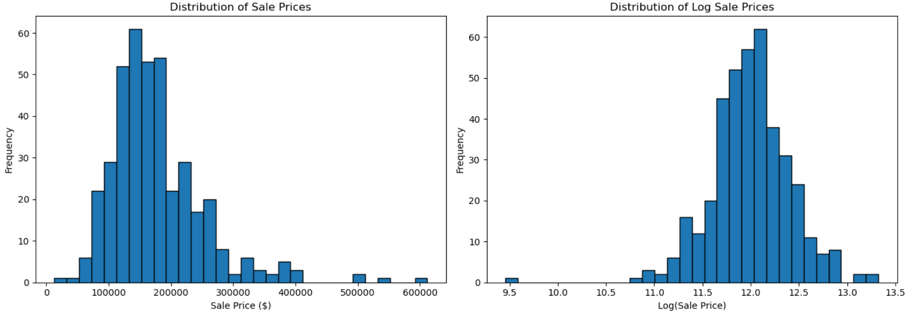
Analysis – Exploratory Data Analysis
A random sample of 400 homes was selected and explored from the original dataset of 2929 houses.
Key findings:
Sale price distribution is right-skewed.
Several columns had a high proportion of missing data.
Top correlated features included Overall.Qual and area (Living Area).
Columns with > 60% data missing were removed.
Missing data in categorical columns were filled with ‘None’ and numeric columns were filled with zero.
Resulting clean dataset had 400 houses, 75 variables, and zero null values.
Distribution of Sale Prices (Left) and Log Sale Prices (Right)
Median sale price = $160k
Mean sale price = $177k
Standard deviation = $75k
Notes:
The higher mean relative to the median confirms the right skewness.
Figure (Left): Histogram of sale prices in the dataset showing price distribution that is right skewed (1.70).
Figure (Right): Natural log transformation of the data which results in a closer to normal distribution.

Slide 6
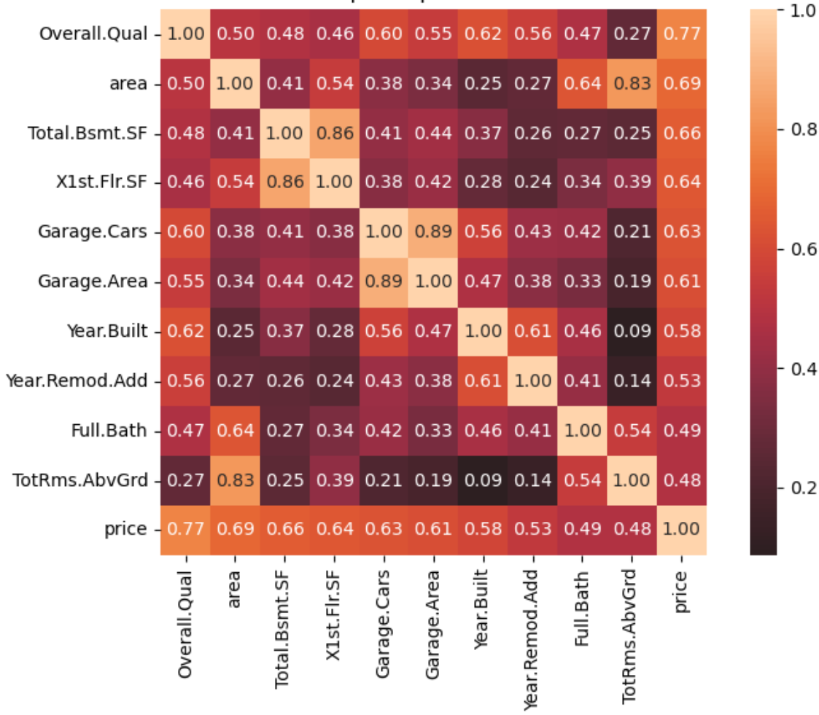
Analysis – Research Question 1 What physical attributes of a home most strongly predict its sale price?
Correlation coefficients were calculated between all numeric variables and sale price.
Highest correlations:
Overall.Qual (Overall Quality): 0.77.
Area (Living Area): 0.69.
Provided insight into inter-column patterns:
Garage.Cars and Garage.Area correlated at 0.89.
X1st.Flr.SF and Total.Bsmt.SF correlated at 0.82.
Indication variables may measure similar features.
Garage.Area and X1st.Flr.SF excluded from the regression models to reduce redundancy.
Correlation Heatmap of Top 10 Sale Price Predictors
Notes:
Useful visual in feature selection and helped to ensure the regression model captured distinct features

Slide 7
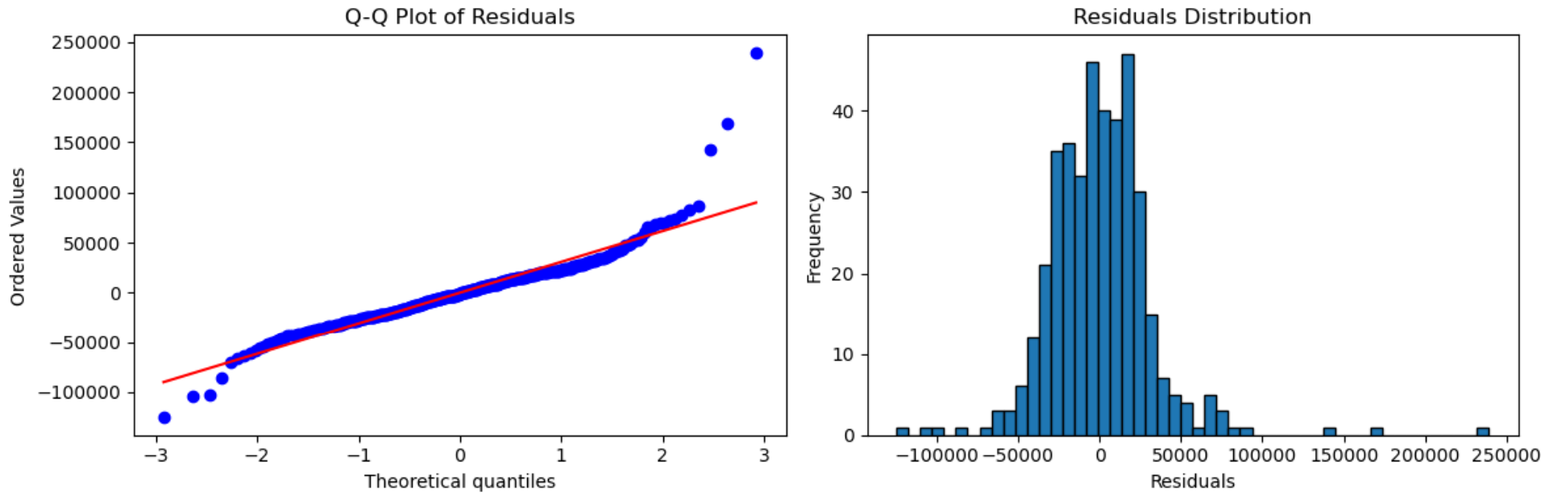
Analysis – Research Question 1 What physical attributes of a home most strongly predict its sale price?
Statistical Methods/Tests:
Multiple Linear Regression.
F-test for model significance and t-test for each coefficient.
Results:
The top six correlated physical features explain 82% of the variance in sale prices.
Physical features are a strong predictor of sale price.
Reject H₀ - At least one physical feature predicts sale price.
Multiple Linear Regression Model Summary
Statistic | Value
R² | 0.82 (82% of variance explained)
F-statistic | 290 (significant)
p-value | < 0.0001
Q-Q Plot of Residuals (Left) and Residuals Distribution (Right)

Slide 8
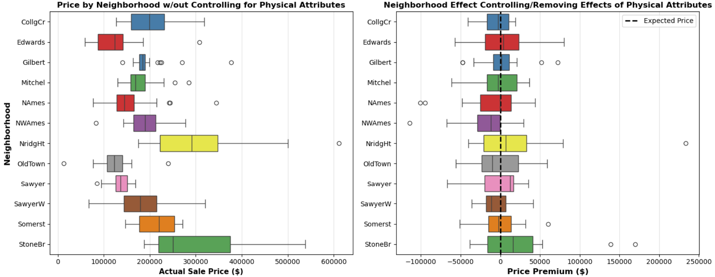
Analysis – Research Question 2 Does neighborhood significantly affect home sale prices with house size, quality, and other impactful variables controlled?
Statistical Methods/Tests:
ANOVA F-test two model comparison.
Results:
Neighborhood effects range from roughly -$25k to +$30k after controlling for physical features.
Physical attributes remain the primary driver of price, explaining 82% of the variance.
Reject H₀ - Neighborhood significantly affects sale price beyond physical attributes.
ANOVA Model Comparison
Model | R² | F Statistic | p-value
Model 1 (Physical Features Only) | 0.816
Model 2 (Physical Features + Neighborhood) | 0.841
Delta R² | 0.025 | 3.015 | 0.000029
Neighborhood Prices Before (Left) / After (Right) Controlling for Physical Features

Slide 9
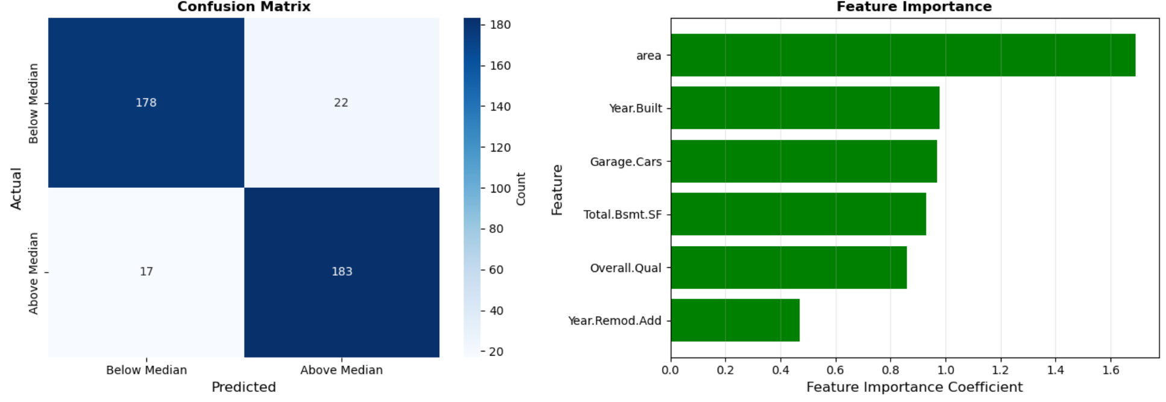
Analysis – Research Question 3 Can it be predicted whether a house will sell above the median price based on its features?
Statistical Methods/Test:
Logistic Regression.
Binomial Z-Test + 95% Confidence Interval.
Results:
A home’s physical features can be used to accurately predict whether a home sells above or below median price.
The model achieves a 90.25% accuracy classifying homes as above or below the median of $160k.
Reject H₀ - Z-stat of 16.1 and p-value < 0.0001 indicate that the model performs significantly better than random chance.
Binomial Z-Test Summary
Statistic | Value
H₀ | 0.50 (random chance)
Z-Statistic | 16.1
p-value | < 0.0001
95% Confidence Interval | 87.34% - 93.16%
Logistic Classification: Confusion Matrix (Left) and Feature Importance (Right)

Slide 10
Conclusions and Key Findings
What physical attributes of a home most strongly predict its sale price?
Research Question 2
Does neighborhood significantly affect home sale prices with house size, quality, and other impactful variables controlled?
Can it be predicted whether a house will sell above the median price based on its features?
Reject H₀. Logistic regression can accurately predict whether a home will sell above or below median price based on its features with a 90.25% accuracy. Z = 16.1, p < 0.0001.
Research Question 1
Neighborhood significantly affects price with F = 3.01 and p-value = 0.000029.
Reject H₀. Physical features drive price variance.
Research Question 3
Multiple linear regression shows that area, overall quality, basement size, garage capacity, and year built/remodeled are all significant. R² = 0.82, p-value < 0.0001.
Reject H₀: Neighborhood has a significant effect on price.

Slide 11
Backup

Slide 12
References
De Cock, Dean. "Ames, Iowa: Alternative to the Boston housing data as an end of semester regression project." Journal of Statistics Education 19.3 (2011).
Scikit-learn: Machine Learning in Python, Pedregosa et al., JMLR 12, pp. 2825-2830, 2011.
Harris, C.R., Millman, K.J., van der Walt, S.J. et al. Array programming with NumPy. Nature 585, 357–362 (2020). DOI: 10.1038/s41586-020-2649-2.
J. D. Hunter, "Matplotlib: A 2D Graphics Environment", Computing in Science & Engineering, vol. 9, no. 3, pp. 90-95, 2007.
Waskom, M. L., (2021). seaborn: statistical data visualization. Journal of Open Source Software, 6(60), 3021, https://doi.org/10.21105/joss.03021.

Slide 13
Methodology and Assumptions Validation
Research Question 1: Multiple Linear Regression
Linearity: confirmed through scatter plots.
Normality: verified using Q-Q plot residuals.
Constant Variance: residuals show minimal fanning or funneling.
Mean of 0: residuals were not uniformly above 0 or below 0 for any subsection.
Independence: confirmed unique homes sales with no duplicates.
Outliers: < 3% impact.
Research Question 2: ANOVA
Normality: verified using Q-Q plot residuals.
Constant Variance: residuals show minimal fanning or funneling.
Mean of 0: residuals were not uniformly above 0 or below 0 for any subsection.
19 neighborhood dummy variables mapped correctly.
Sample Size: all neighborhoods had > 7 observations (min: 7, max: 69)
Independence: confirmed unique homes sales with no duplicates.
Research Question 3: Logistic Regression
Confirmed binary outcome of either below (0) or above (1) median
Independence: 400 unique observations, no duplicates
Sample Size: verified adequate sample size.
Binomial test: n*p₀ = n*(1 - p₀) = 200 ≥ 10.

